Slide 1

Welcome to the SLG Sessions for ULI101

Slide 2
Session’s AGENDA( Week 1-6 😊😊 )
OPENING ACTIVITY – Ice Breaker type
TWO MAIN ACTIVITIES – provides hands-on practices for major concepts.
(ONE MAIN + CLOSING ACTIVITY ) – GROUP COMPETITION and checking our understanding
Q/As
Notes:
Or a similar course

Slide 3
ICE BREAKER!!!
Welcome Back Everyone 😊😊!!!!
How were your Mid-Terms 👀👀..?
Questions you STRUGGLED with….?
Notes:
Or a similar course

Slide 4
Activity – 1(BREAKOUT ROOM ACTIVITY)
We will START simple – just creating a directory structure 😉😉
1. create a directory structure as shown in the picture shared !!
2. You have 10 minutes!!
3. keep an eye out for hidden files and directories.
Notes:
Or a similar course

Slide 5
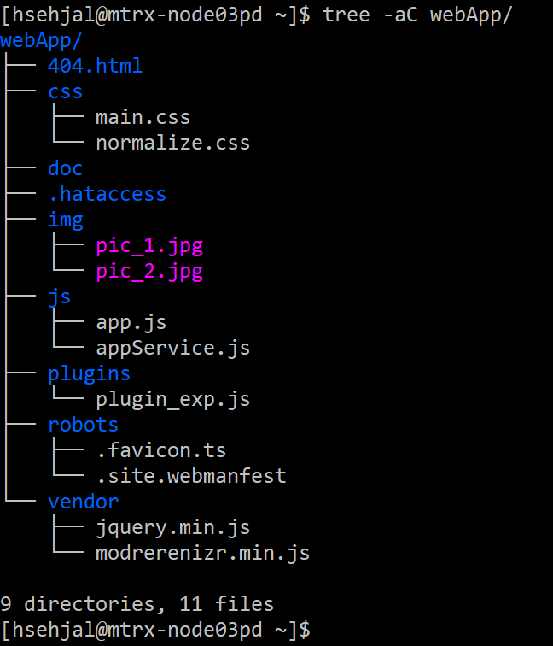
REQUIREMENT:
Notes:
Or a similar course

Slide 6
Activity – 2(BREAKOUT ROOM ACTIVITY)
1. Change your current location to "img" directory meaning you must be inside "img" directory.
2. Using relative Path, Copy directory "css" into directory "vendor". Make sure that you copy the directory "css" as a whole along with its contents.
3. Using relative Path, change your current location to (inside) "plugin_exp" directory.
4. Using relative Path, move the directory "robots" to directory "404.html".
5. Keeping in mind your current location and using absolute Pathname, set permissions of file "pic_1.jpg" to the following:
read and write to users, read and execute to group and execute to others using octal method.
6. Keeping in mind your current location and using relative Pathname, open file "plugin_exp.js" using vim/vi editor.
7. Enter the following Text:
Hi Everyone, my Name is <Replace with your Full Name>
My Professor Name is <Replace with your Professor's Name>
My Section is <Replace with your Section Name>
My Feedback for SLG Session is "Your Feedback here"!!
Notes:
Or a similar course

Slide 7
REQUIREMENT:
BEFORE starting the QUESTIONS:
ACTIVITIES will be a GROUP WORK
Anyone can volunteer to be the group representative
After 12 minutes, we will be discussing and then group representatives will be the ones answering questions on behalf of their group
You can share screens as well as use your microphone in breakout rooms to communicate with your groupmates
This is an open book so feel free to use external resources – notes, websites, etc.
Good luck and please keep in mind – THIS IS A GROUP ACTIVITY AND NOT AND INDIVIDUAL PRACTICE
Notes:
Or a similar course

Slide 8
Activity - 3(- GROUP COMPETITION!! 🎃 🎃)
1. change your current location to "vendor" directory using relative Path.
2. Now, using relative pathname, send the file "plugin_exp.js" as an attachment in an email to your "seneca email address" with Subject line "Slg Sessions"
3. Using a single linux command, list all the files and directories in webApp directory, display the output to screen and also save it in a file named "listing.css" inside css directory using a single linux command. (use relative Pathname and NO REDIRECTION).
4. Using a single linux command, perform the following set of operations!!
- translate the contents of file "plugin_exp.js" to UPPERCASE using linux utility and save it in a file "translate_1.css" inside "css" directory.
- count the number of words, lines and characters in the translated contents and save it in a file "count.css" inside "css" directory
(* At every step, use relative pathname and the whole operations needs to be a single linux command[hint -> piping])
5. Using a single linux command, perform the following set of operations!!
- translate the contents of file "plugin_exp.js" to lowercase using linux utility and save it in a file "translate_2.css" inside "css" directory.
- display only fields "1,3,6,7" of translated text and append it in a file "jquery.min.js" inside "vendor" directory.
- sort the contents of the previous command in reverse order and save output to a file "modrerenizr.min.js" - (overwrite the contents of this file and no output should display on the screen. It should only be saved in the file "modrerenizr.min.js").
(* At every step, use relative pathname and the whole operations needs to be a single linux command[hint -> piping])
Notes:
Or a similar course

Slide 9
ADDITIONAL RESOURCES:-
https://www.geeksforgeeks.org/
THANK YOU FOR JOINING THE SLG SESSION!
Notes:
Or a similar course

